Slide 1
Identity Development in School: The Critical Role of Teachers
Rainbow History Month Colloquium
Nancy Commins – Clinical Professor Emeritus
University of Colorado, Denver
Senior Fellow
Turun Yliopisto
11 November 2019

Slide 2


Kieli- ja kulttuuritietoisen opettajuuden ja opettajankoulutuksen edistäminen
My talk is sponsored by
dyk i diversitet
buokčal gillii ja kultuvrii

Slide 3
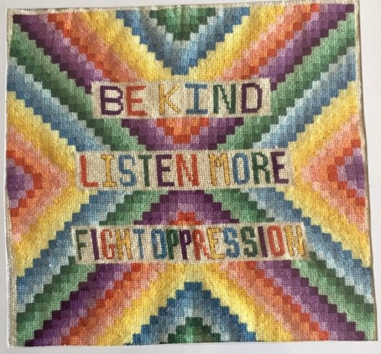
Intentional infusion of linguistically responsive and culturally sustaining understandings and practices.
Explicit recognition of interplay of external socio-political context and student outcomes and success

Slide 4
3 Central Themes
Schools are a site for identity development
Teachers’ play a critical role in supporting or undermining students’ identities
Everything takes place within the lines of power and privilege of the larger social context

Slide 5
Assumptions about Schooling
Nothing about teaching is neutral
Teaching is political
Linguistic and cultural diversity is the norm for which all teachers must be prepared
The dominant culture’s values and interests frame our behaviors
Schooling is a process of identity development

Slide 6
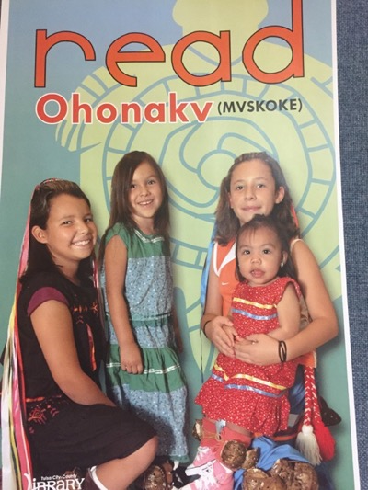
Equity in Education Linda Darling-Hammond – 2016 Conference Presentation
Addressing the academic, psychological, emotional, social needs [and assets] of all students
Recognizing differences
Compensating for disadvantages [structural inequities]
Responding to the needs [and assets] of all students”

Slide 7
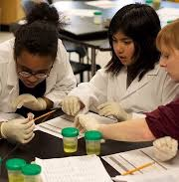
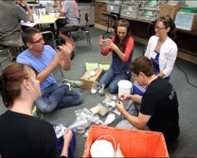
Equity Focused Teachers
Learn about...
Interact with...
Connect to...
Care about…
Advocate for…
All of their Students
Notes:
STAMP THE LEARNING--these are means of meditation

Slide 8
What is IDENTITY? Margaret Wetherell (2010) Sage Handbook of Identities - Introduction
Elusive and difficult to define
‘Names & looks’ and what is done with these
Us vs them
Binaries vs fluidity
Social organization of memory
Assemblages and re-assemblages
Intersectionality
Assumed and imposed
Essentialism vs social constructivism
A sense of self in relation to others

Slide 9
Different Paths in the Field
Subjective individual achievement – A felt sense of personal place, continuity & location – field has move to seeing these personal and subjectively felt identities as mobile, flexibly negotiated, practically oriented and jointly accomplished with others.
Study of social divisions and social solidarities and the practices of marginalization, exclusion, inclusion, resistance, segregation, denigration linked to belonging. P. 4. Social categories
The ethical and political. How to live and how to act brings personal and social together.

Slide 10

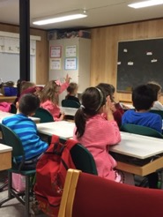
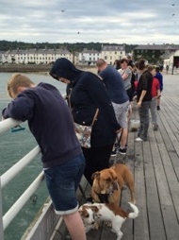

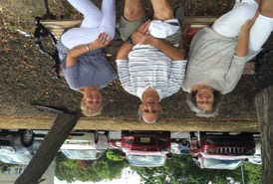
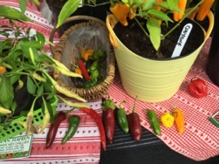
How is your identity constructed?
Heritage culture
Language
Ethnicity
Gender Expression
Religion
Geography
Home culture
School culture
Professional culture
Age, gender, hobby cultures
Classroom cultures

Slide 11
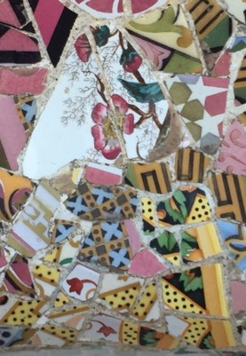
The Past, Present, and Future of an Identity Theory
Sheldon Stryker and Peter J. Burke
Social Psychology Quarterly
Vol. 63, No. 4, Special Millenium Issue on the State of Sociological Social Psychology (Dec., 2000), pp. 284-297
Identity refers to an internalized set of meanings attached to a role played in a network of social relationships, with a person’s self viewed as, in important part, an organization of the various identities held by the person’’ (p. 6).

Slide 12
From Kaylyn William’s 2017 Capstone Definition of Identity
Tracy Robinson
Individual identity is
“both visible and invisible domains of the self that influence self-construction. They include, but are not limited to, ethnicity, skin color, gender, sexual orientation, nationality, and physical and intellectual ability.”
Edward Taylor: Cultural identity is “one’s understanding of the multilayered, interdependent, and nonsynchronous interaction of social status, language, race, ethnicity, values, and behaviors that permeate and influence nearly all aspects of our lives.”
Notes:
An identity is a multifaceted, fluid understanding of and belief in oneself. Embedded in the term identity is an understanding of one’s individual and cultural identity. Author Tracy Robinson defines individual identity as, “both visible and invisible domains of the self that influence self-construction. They include, but are not limited to, ethnicity, skin color, gender, sexual orientation, nationality, and physical and intellectual ability.”12 Cultural identity is best defined by Edward Taylor as, “one’s understanding of the multilayered, interdependent, and nonsynchronous interaction of social status, language, race, ethnicity, values, and behaviors that permeate and influence nearly all aspects of our lives.”

Slide 13
Esteban-Guitart & Moll (2018)
Identity—as with any other higher order psychological process—is essentially social in origin. People actively appropriate discourses, narratives, and visions or models of identity, but this is always cultural material.
Identities comprise all those people, skills, knowledge, practices, and resources that people have acquired and now use through their involvement in their various activities, in diverse social interactions.
These artifacts are internalized as well as externalized. People form their identities (visions of themselves) by engaging in social activities and by observing how members interact.

Slide 14
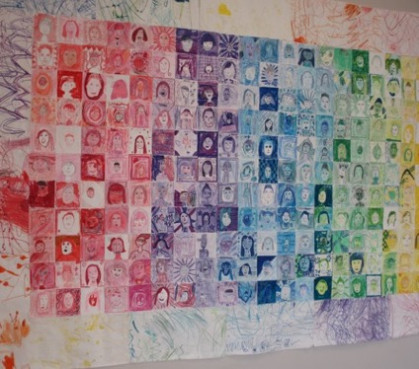
Lived experience, funds of identity and education Culture & Psychology 2014, Vol. 20(1) Moisès Esteban-Guitart & Luis C Moll
Funds of Identity
Not always visible
A process that takes place in interaction with the environment, with people (family, friends, community) and things, with signs and tools distributed among artefacts and with the funds of knowledge available; all of this across various different places and times.

Slide 15
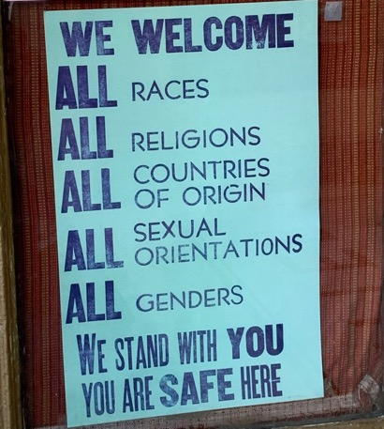
The multiple dimensions of identity affect how we act and are perceived
Notes:
The dilemma of: teachers own ethics versus curriculum guidelines.
What kind of things can be negotiated? why?
What kind of things can not be negotiated? why not?

Slide 16
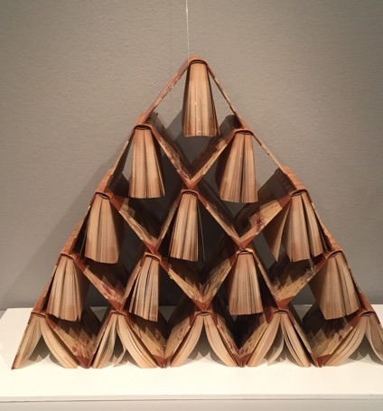
A site of Continuous Unsettled Argument
I am not here to argue for a particular position coming from the complex and nuanced field of identity
I come as an educator who has spent her entire career as an educator seeking equity for traditionally marginalized students.
Art by Alexander Reichstein photo taken at Salon Taidemuseo

Slide 17
Move from either / or to neither / both something else.
Allow students to be recognized as a person, as part of a community, a polity, a family or any other kind of human group.

Slide 18
Why do teachers need to pay attention to identity development?
…..[c]hildren live in a world that is not yet a place where all of them have equal opportunity to become all they could be.
We know children need to feel safe and secure in all their many identities, feel pride in their families, and feel at home in [school].
We also know that children need tools to navigate the complex issues of identity diversity, prejudice, and power in their daily lives so that they may learn thrive and succeed.
From: Julie Olsen Edwards and Louise Derman-Sparks (2010) Anti-bias Education for Young Children and Ourselves. NAEYC

Slide 19
The importance of MESSAGE
As a teacher you send powerful messages about the worth of each student by what you say and do about cultural and linguistic diversity.
You can disrupt or perpetuate oppression and discrimination by how you treat your students and model for them how to treat each other.

Slide 20
The nature of teacher-student relationships is central to student learning
“The way students are thought about and treated by society and consequently by the schools they attend and the educators who teach them is fundamental in creating academic success or failure.” Sonia Nieto
Pg. 167 The Light in Their Eyes: Creating Multicultural Learning Communities. Teachers College Press

Slide 21
My Belief
Every child
no matter their background
no matter their circumstances
Deserves a teacher who
Cares deeply about them as an individual and their success as a learner
and
Sees their potential to contribute to society as a whole when they become adults

Slide 22
Teachers’ Actions Matter
Only thing truly within control of a teacher:
the relationships they construct with and among their students.
Teachers have to power to make students feel loved or unlovable, a part of the class family or an outsider.
Must insist on the intrinsic worth and dignity simply for being human

Slide 23
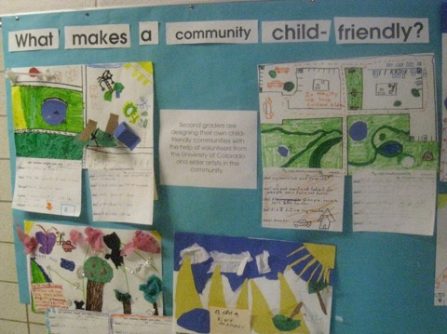
Maximize academic and social opportunities, rather than reproduce social inequities in our communities
Nurture a healthy psychological frame of mind in all students regardless of gender expression, sexual orientations, language, social status, ability, religion, race or interests

Slide 24
Students have to work out who they are (and are not) within the constraints of the particular institutions (physical and virtual) in which they spend their time.
You can only be who you are
But you can still combat
both actual and symbolic violence

Slide 25
An Example: Gender Stereotyping
Coercive behaviors on the part of teachers to insist that students who present themselves as representing one gender / sex or the other must perform in particular ways
Fixed gender separation in toys, clothes where to set, how to talk.

Slide 26
What happens when a feature of your identity is marginalized in school?
from Louise & George Spindler (1993)
Enduring Self – sense of continuity of experience, meaning & social identity
Situated Self – contextualized and instrumental, changes selectively to meet the demands of the context
Endangered Self – sustained violation of enduring self – damaged identity
Pathways to Cultural Awareness: Cultural Therapy With Teachers and Students

Slide 27
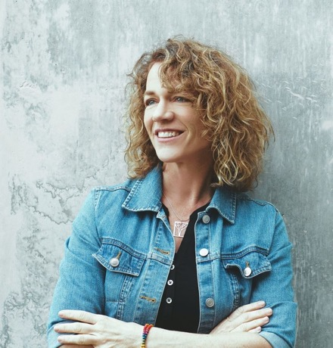
Author Robin Stevenson wrote an open letter to Wheaton Warrenville Unit District 200 after officials canceled her school visit. Here's what it said, edited for newspaper style:
From Daily Herald. Suburban Chicago. November 6 2019
https://www.dailyherald.com/news/20191106/read-authors-letter-to-wheaton-warrenville-district-200-after-her-school-visit-was-canceled?fbclid=IwAR0ZqIJ8HAYqsKri85Za1OtN1jH25hBolVy-r9vzIF35IL8hrLf-ihAj_4U

Slide 28
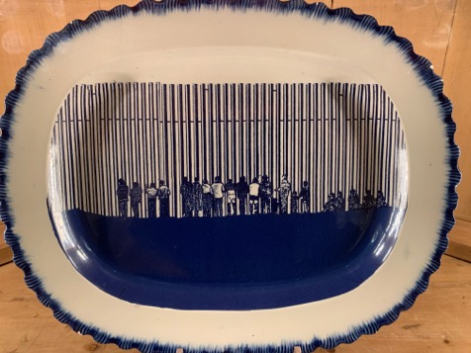
Advocacy for Students
Need to be willing to take action to improve students’ access to social and political capital and educational opportunities

Slide 29
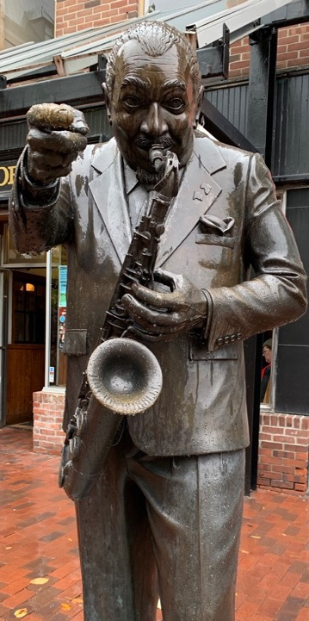
Resilient Students:
Adapt to disturbances to functioning and development
Respond to stress in a way that does not impact an individual behaviorally or psychologically
Use resources towards positive outcomes
Function in a positive way after adverse events
Are vulnerable to adverse events
From; "Supportive Relationships and Active Skill-Building Strengthen the Foundations of Resilience: Working Paper 13." National Scientific Council on the Developing Child, 2015.
Notes:
Harvard University has produced a working paper that describes five
defining features of an individual who is resilient. These include:
1) The ability to adapt to disturbances to functioning and development
2) The ability to respond to stress in a way that does not impact an individual behaviorally
or psychologically
3) The ability to use resources towards positive outcomes
4) The ability to function in a positive way after adverse events
5) The ability to be vulnerable to adverse events24
24 "Supportive Relationships and Active Skill-Building Strengthen the Foundations of Resilience:
Working Paper 13." National Scientific Council on the Developing Child, 2015.

Slide 30
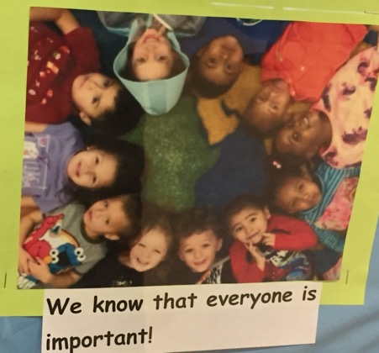
NAEYC Wanless & Crawford (2016) p. 3
Help students feel welcome and connected to their teachers and peers
Show children that we see and value all aspects of them—including attributes related to gender expression, sexual orientation, race and culture
This means integrating their identities into the materials, pictures and actions in the classroom

Slide 31
Why don’t most people from the dominant group fight oppression?
They don’t know it exists in the first place
They don’t have to
They think it’s just a personal problem - individuals usually get what they deserve
They want to hang on to their privilege
They’re prejudiced – racist, sexist, heterosexist, ableist, classist
They’re afraid
Johnson, Allan G. (2001). Privilege, power, and difference. Boston: McGraw-Hill,

Slide 32
KEY QUESTIONS RELATED TO IDENTITY & EDUCATIONAL EQUITY
As Teachers
Students
Curriculum
Environment
What are their cultural backgrounds?
What do they know about others who are different from them?
How do they learn best?
What is the emotional and psychological climate of my classroom?
How do I control the environment?
What needs of students do I attend to?
What do I know about myself? My attitudes and beliefs?
What do I know about others who are different from me?
How do I teach?
For whom are the curriculum and the materials designed?
What do they teach about differences?
What attitudes and beliefs do they instill?

Slide 33
Key Questions for Educators:
Ourselves
What do I know about myself and my attitudes and beliefs?
What do I know about others who are different from me?
How do I teach and do I reach all students?
Are there some students I’d rather work with more than others?

Slide 34
Key Questions for Educators:
Students
What is their cultural background (along multiple dimensions of identity)?
What do they know about others who are different from them?
How does each student learn best?

Slide 35
Key Questions for Educators
Curriculum
Who are the curriculum and the materials designed for?
What does the curriculum teach about difference?
What attitudes and beliefs do they instill?

Slide 36
Key Questions for Educators
Environment
What is the emotional /psychological climate of my classroom?
How do I control the environment?
What needs of the students do I attend to?

Slide 37
We Are All the Same We Are All Different
Project with Class 5C
Turun Normaalikoulu
Kevät 2012
Based on Guidelines from the Anti-Defamation League
https://www.adl.org/education/resources/tools-and-strategies/anti-bias-curriculum-guides

Slide 38
Goal of the Research
Determine if students’ attitudes towards others change / improve after focusing on intercultural competence. Open up a global perspective within the context of ethical behavior.
What brings us together?
What divides us?
What can I do to make a difference?

Slide 39
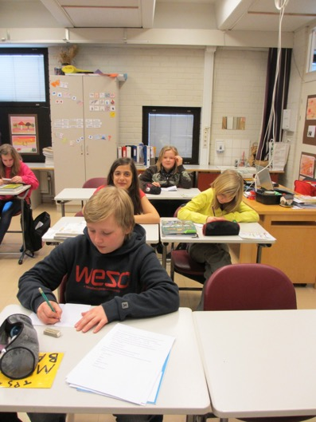
Overview of Activities
Week 1 Shields & Flowers Who are We?
Week 2 Cooperation
Week 3 We can be Allies
Week 4 Role Plays - Going Deeper
Week 5 Synthesize understandings into class quilt. “We Can Make Norssi a Great Place to Learn”

Slide 40
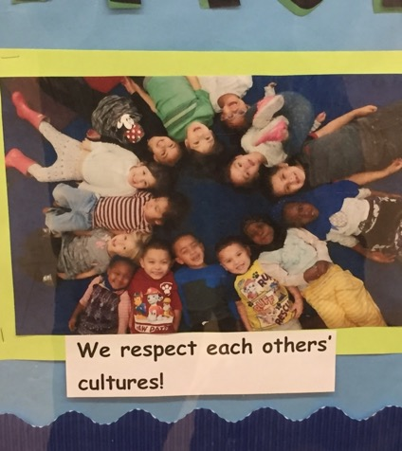
Why are we doing this project?
When you grow up, the most important skills will be to
Get along with
Care about
Learn From
Work For
Respect
People who are different from you
NO MATTER
WHO YOU ARE

Slide 41
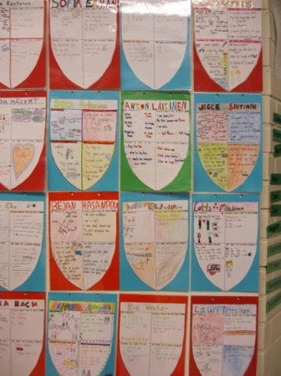
Week 1: Introduction
Each student got two letters to decorate for “We are all the same, we are all different.’’
Introduced myself. Talked about why important.
Modeling of Shield and discussion. Students create own shields which are put on display
3 things in common, 1 different (What you like to eat for a special meal. What you do on the weekends. How your families celebrate birthdays
It makes me happy when, It makes me sad when. When someone is sad I can…

Slide 42
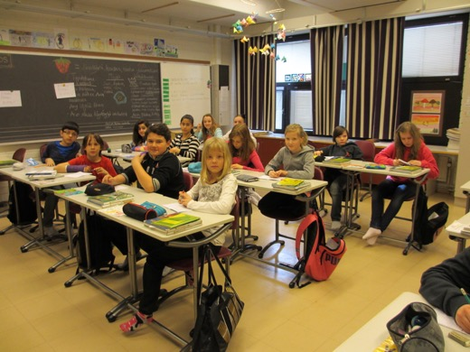
What do you know about different people? Where do you get your information?
People from the U.S. People in wheelchairs
Poor people Roma
FOR EACH GROUP: Have you had Personal Contact YES / NO
If no, have you heard the term, do you know what I am talking about?
If I were a visitor from outer space (from the moon), how would you describe ____________ to me?
What have you heard?
What have you seen?
What has your own personal experience taught you?
How certain do you feel the information is accurate?
Where did you learn most of your information and what did you learn from which source?
Parents- family
TV
Movies
Books
Magazines- comics
School
Personal experience

Slide 43
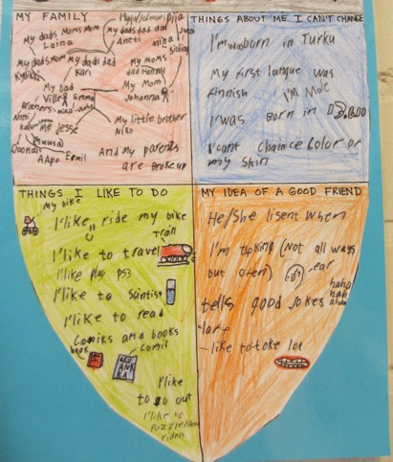
Week 3 Identity & Cultural Practices –
Cultural practices - Over generalization - Stereotypes
Use shield to look at aspects of own identity
Read story “A New Girl” to introduce concepts of Target, Perpetrator, Bystander and Ally
Tie to Respect for Others from Religion class
Create role plays in small groups based on scenarios given in Reading to End Racism materials.

Slide 44
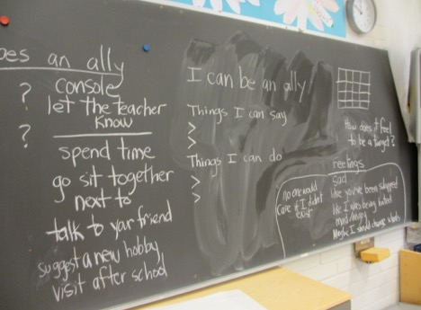
Week 4: What Does an Ally Do or Say?
Review “Why are we doing this project.”
Go deeper into the roles. Write in journals “When you have been a target, how did you feel?. What did people do to make you feel better ?
Final reflection: “Things I can do, things I can say.” Homework: Think about how we can make Norssi a better school.

Slide 45
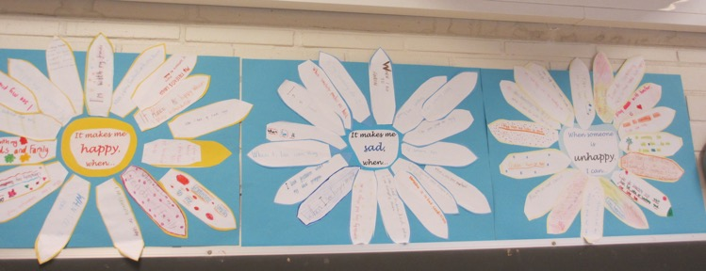
Bring It Together With A Class Quilt
“Inside/Outside Circle” - generate ideas on how to help
Started simple
Began with “When someone is sad” and then expanded.

Slide 46
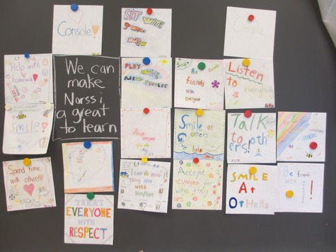
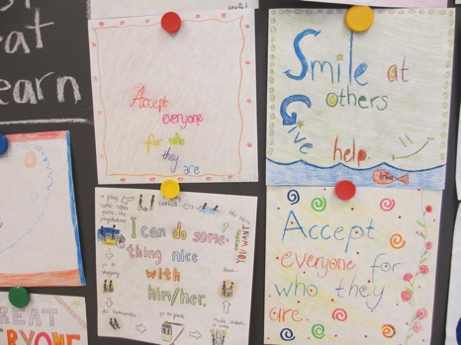
Constructing the Quilt

Slide 47
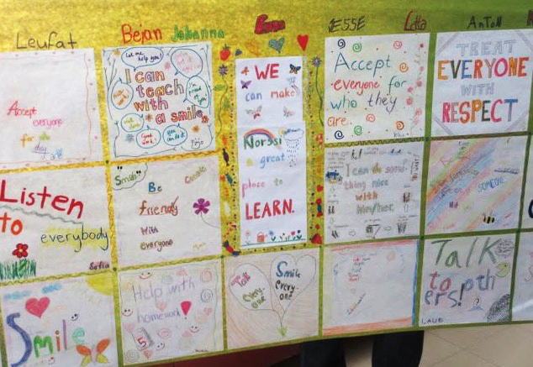

Slide 48

Before you leave, take a moment to reflect: How will you take these understandings forward in your work?

