Slide 1
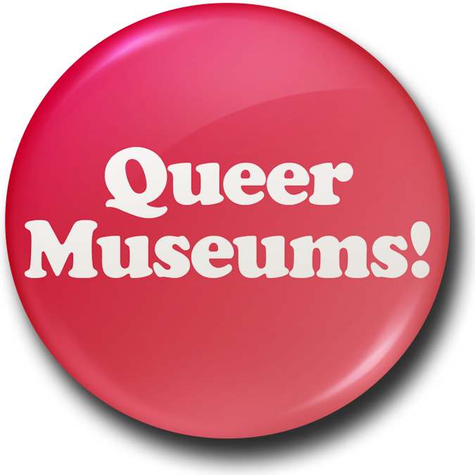
Rainbow History Month and Museums
Therese Quinn

Slide 2
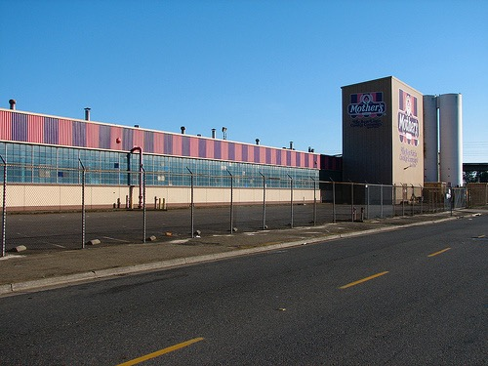
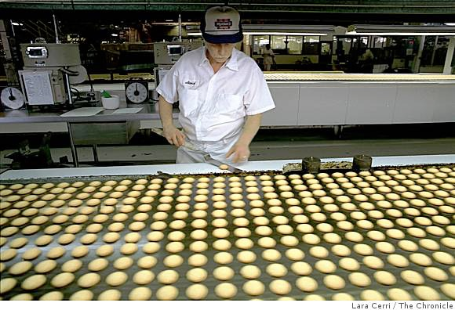
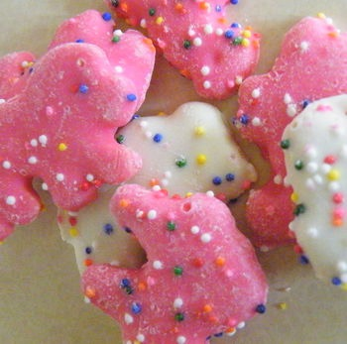

Slide 3
What students cannot consider, they are unable to use, and this has consequences for the kinds of lives they can lead.
Elliot Eisner, 1994

Slide 4
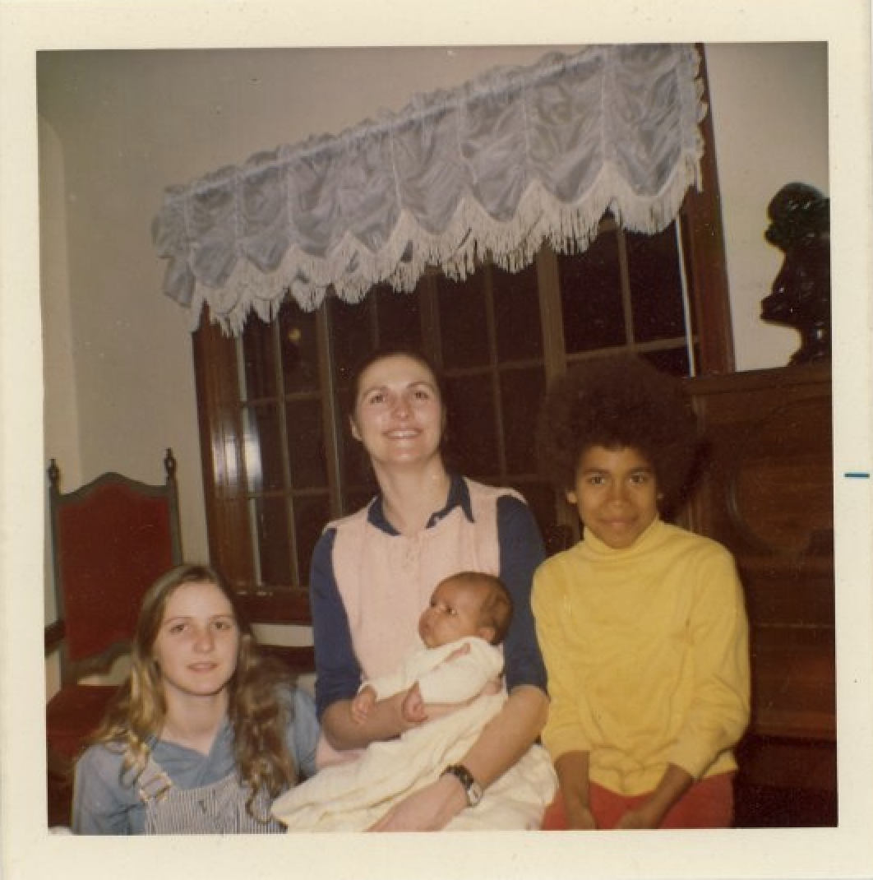
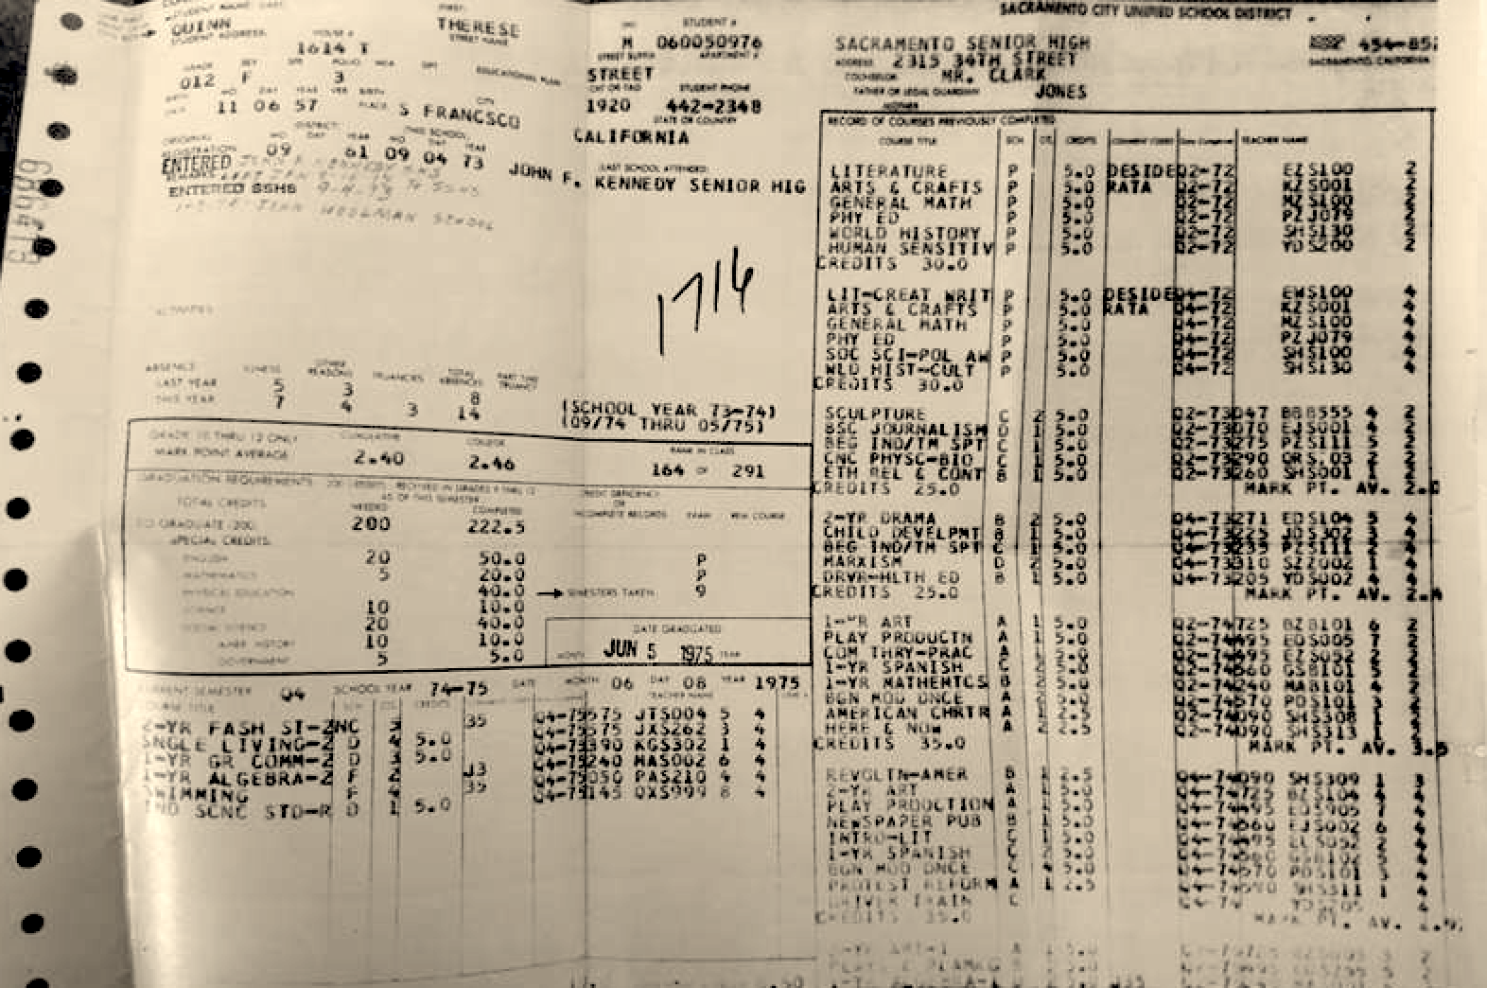

Slide 5
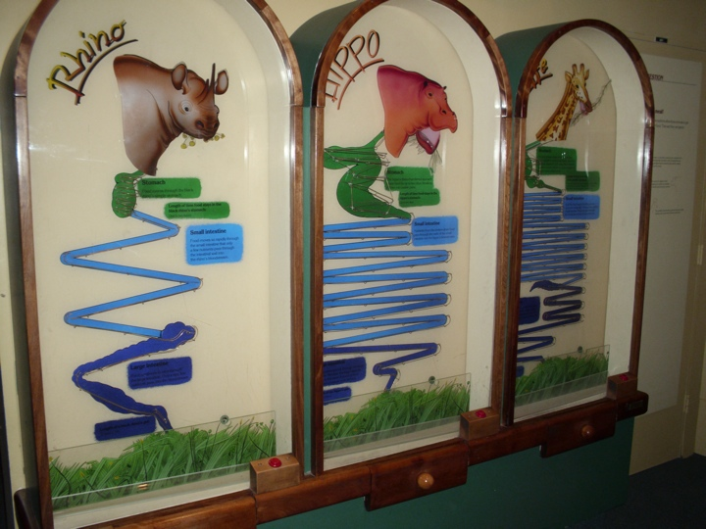

Slide 6
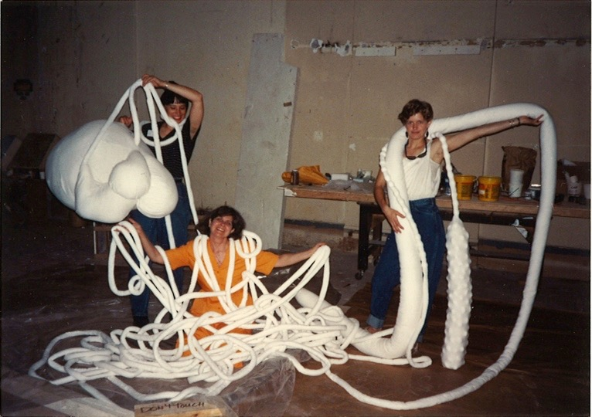

Slide 7
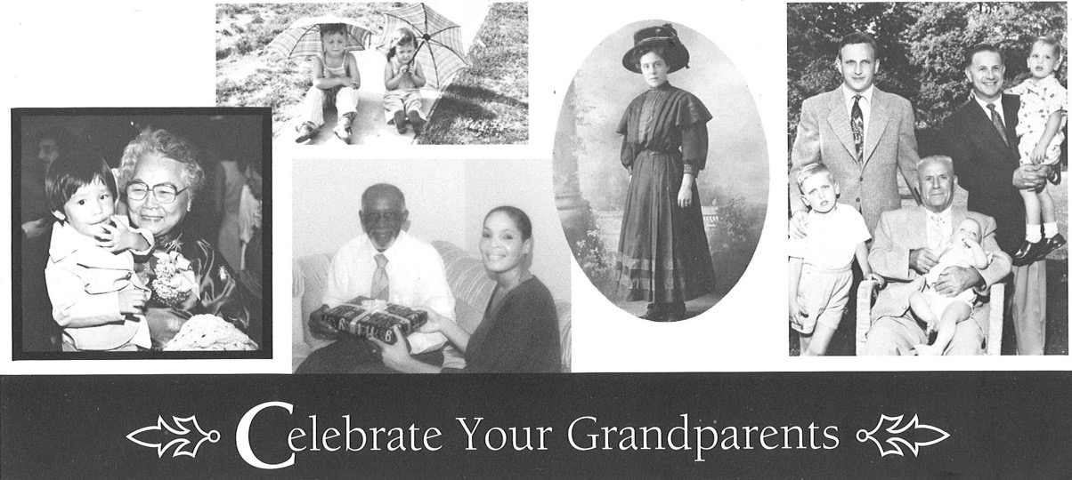

Slide 8
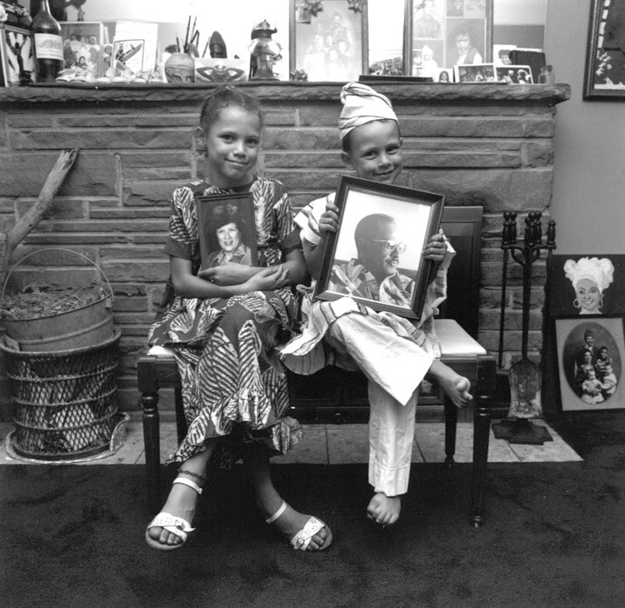
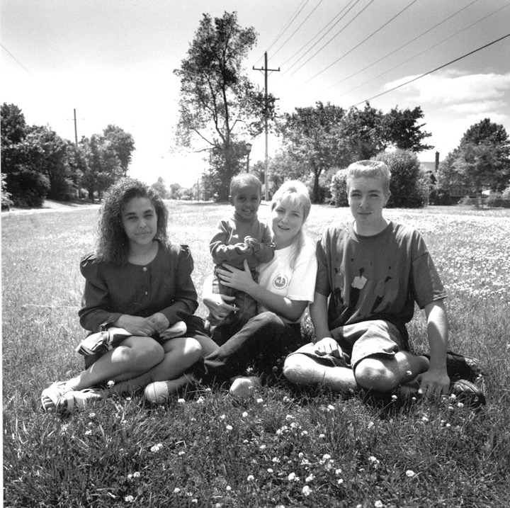

Slide 9
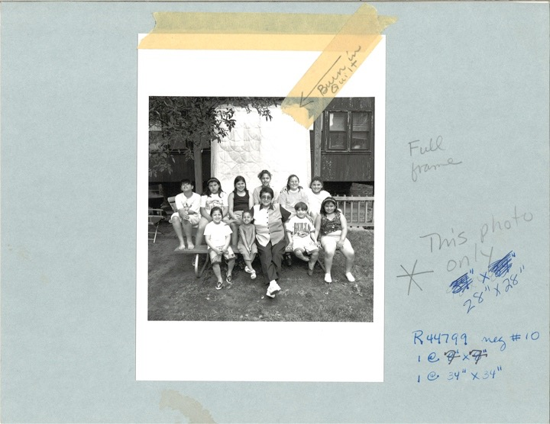

Slide 10
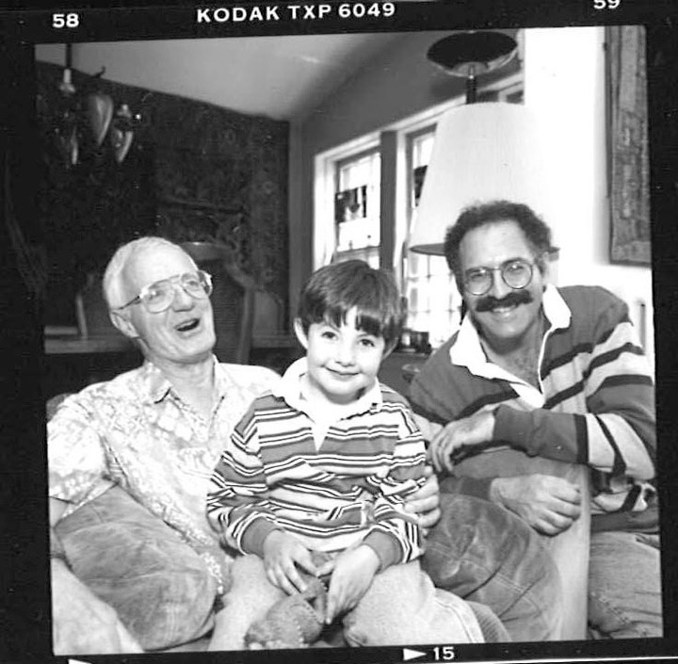

Slide 11
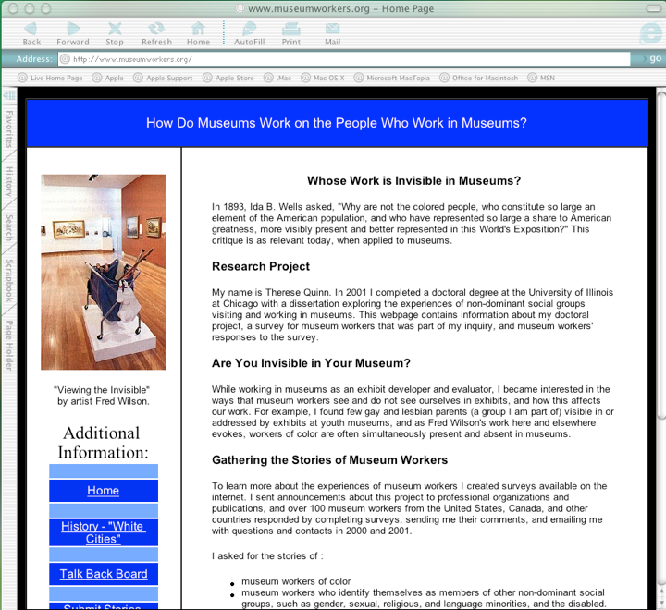

Slide 12
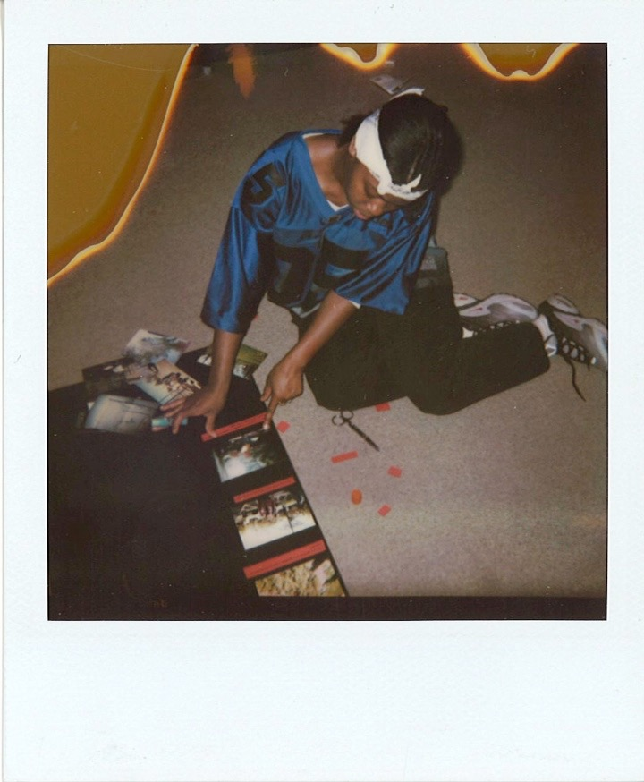

Slide 13
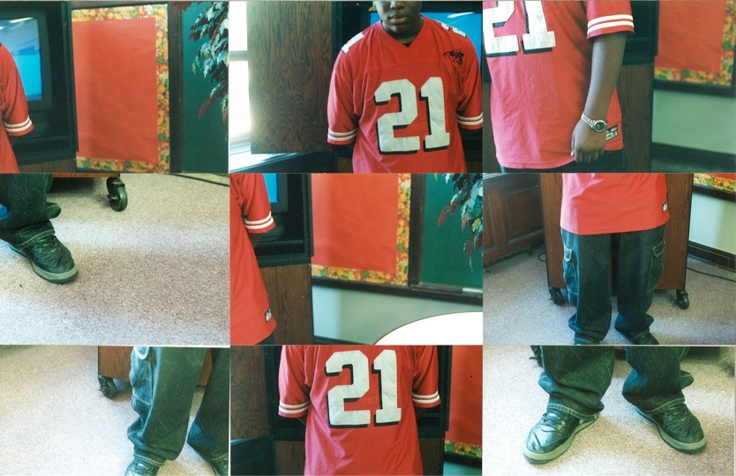

Slide 14
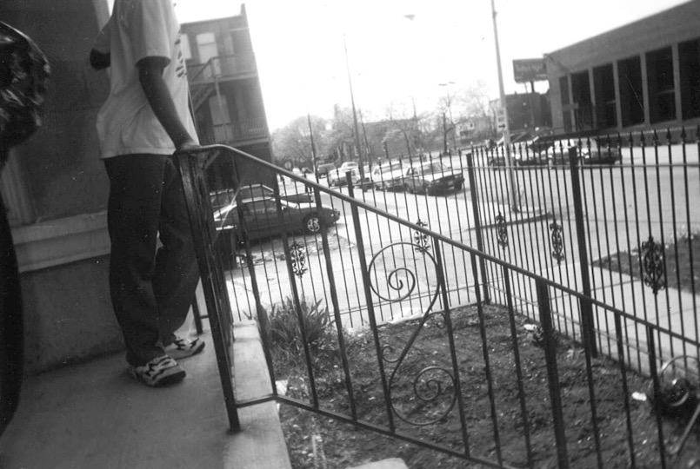
The police station across from my house.

Slide 15
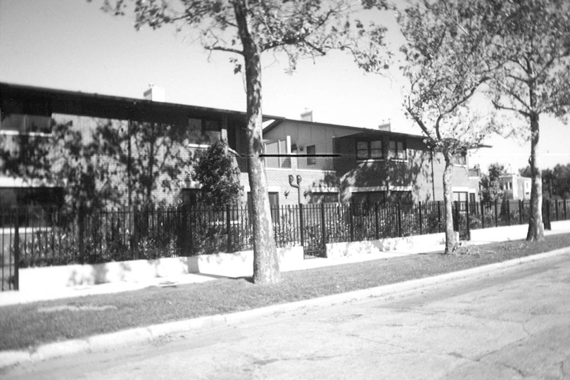
A spot. But not a drug spot.

Slide 16
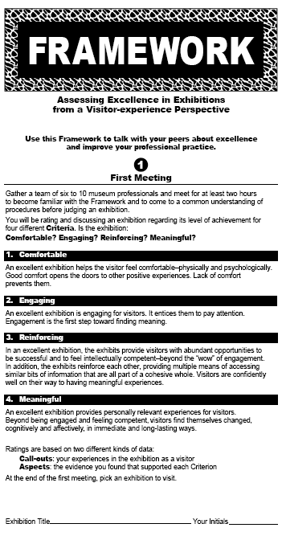

Slide 17
How Can Museums Celebrate LGBTQ People’s Lives and Contributions?
Potential Themes
Lesbian, gay, bisexual, transgender and queer people and histories are delightful and important to know
Communities gain and keep freedom through action
Each of us can choose our gender/s and who we consider “family”
All people and families are worthy of respect

Slide 18
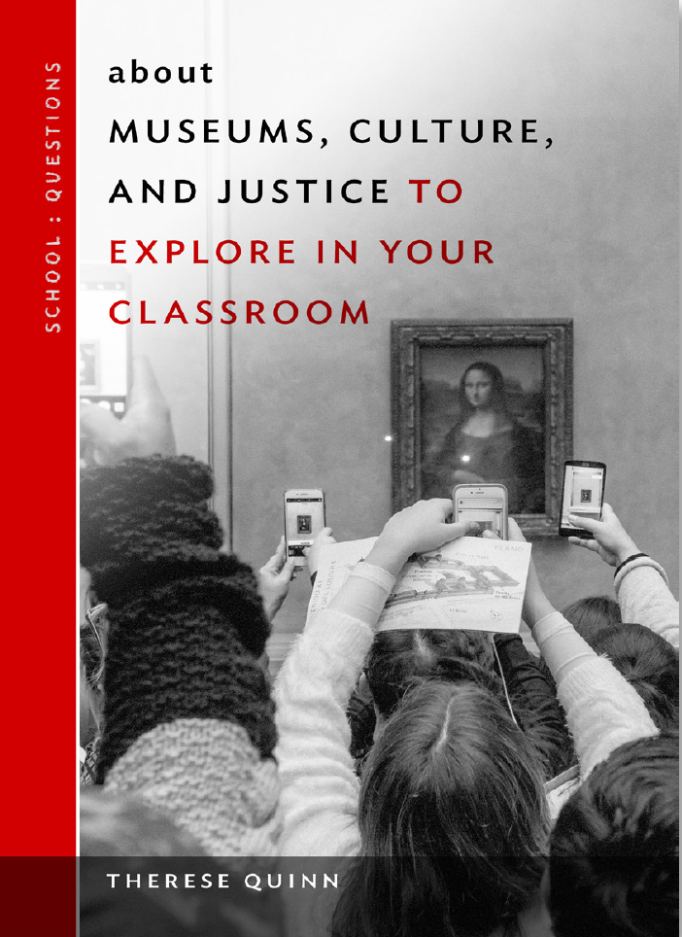

Slide 19
Language Is Alive
LGBT
Lesbian, gay, bisexual, transgender
LGBTQ
LGBTQIA
Intersex
Asexual
LGBT+
Queer
Pansexual
Genderqueer

Slide 20

Sara Schmidt-Kost, 2019

Slide 21
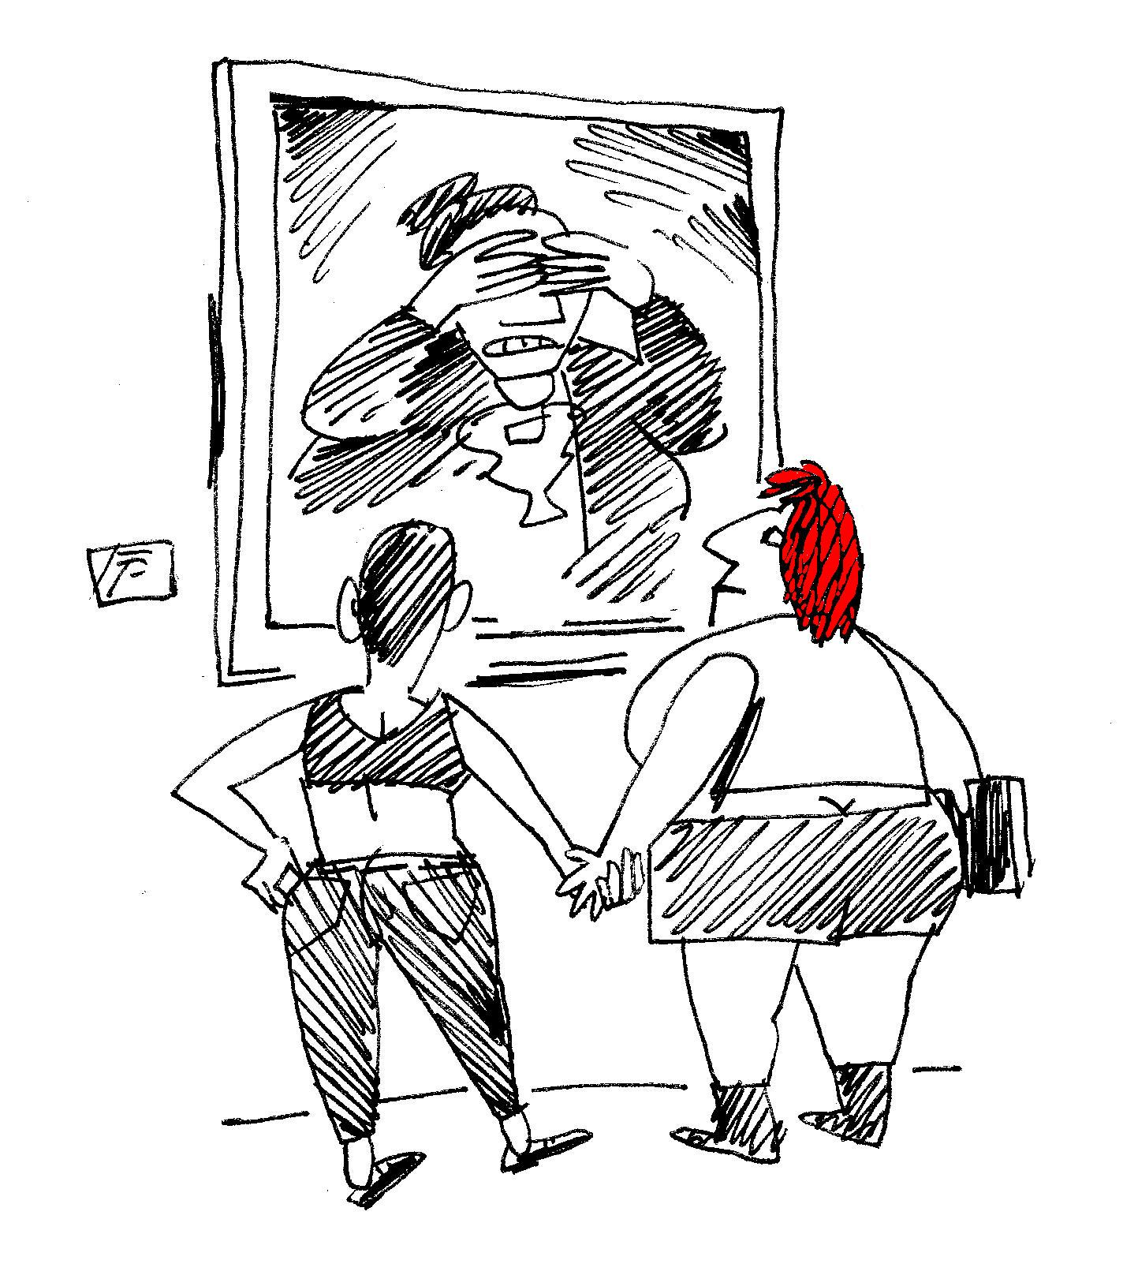
Lesbians holding hands by Tom Hachtman, 2011

Slide 22
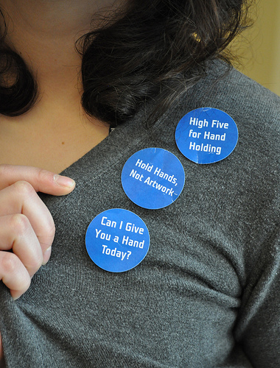

Slide 23
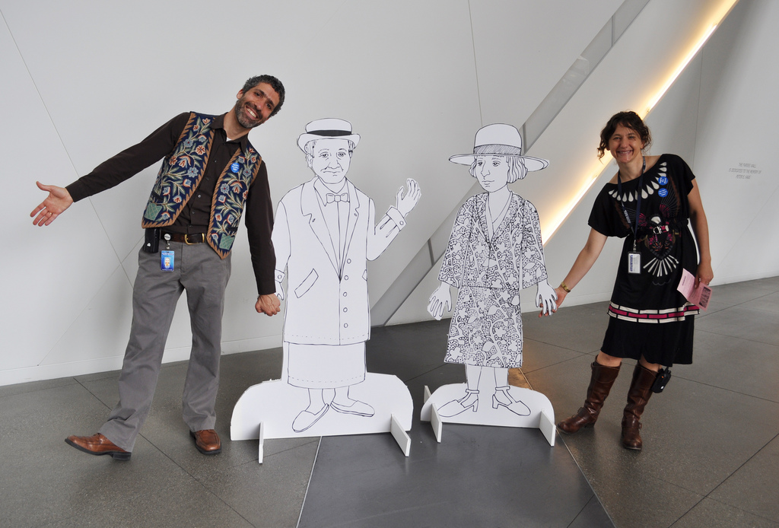

Slide 24
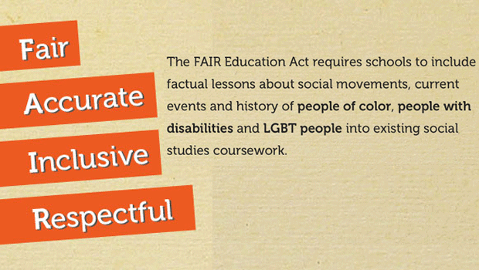

Slide 25
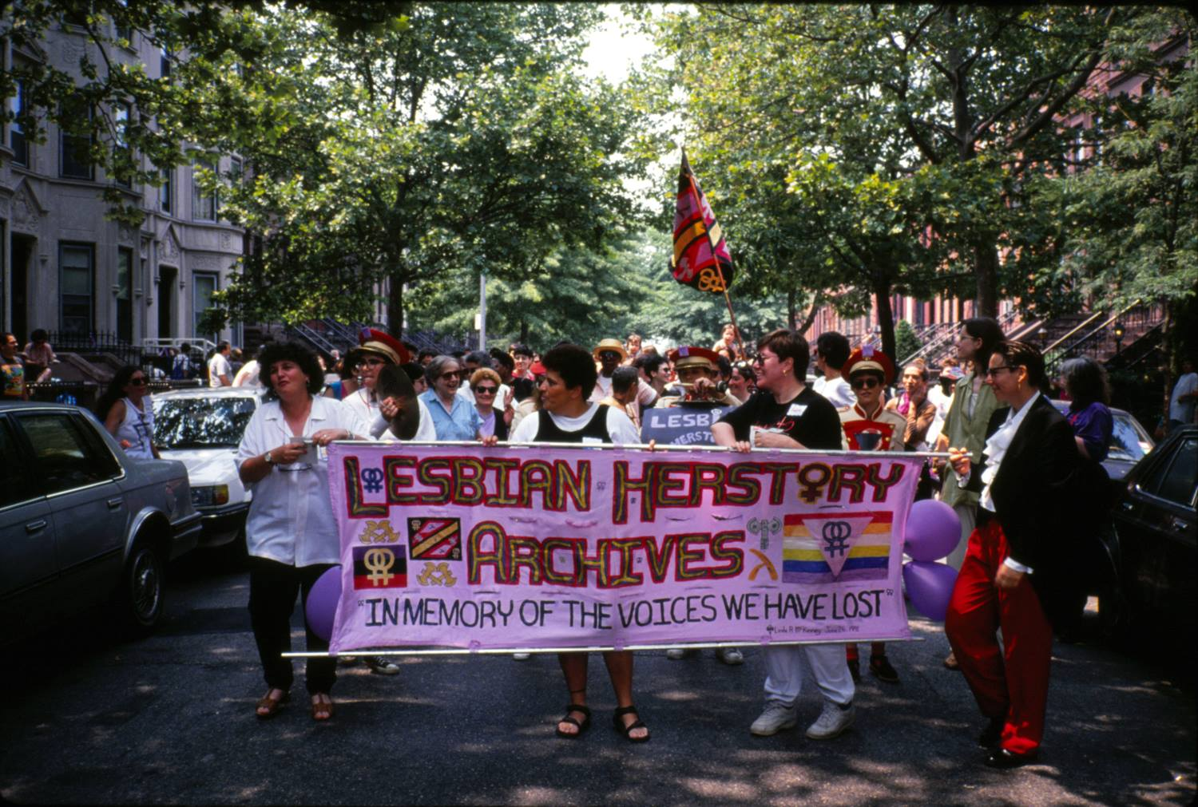

Slide 26
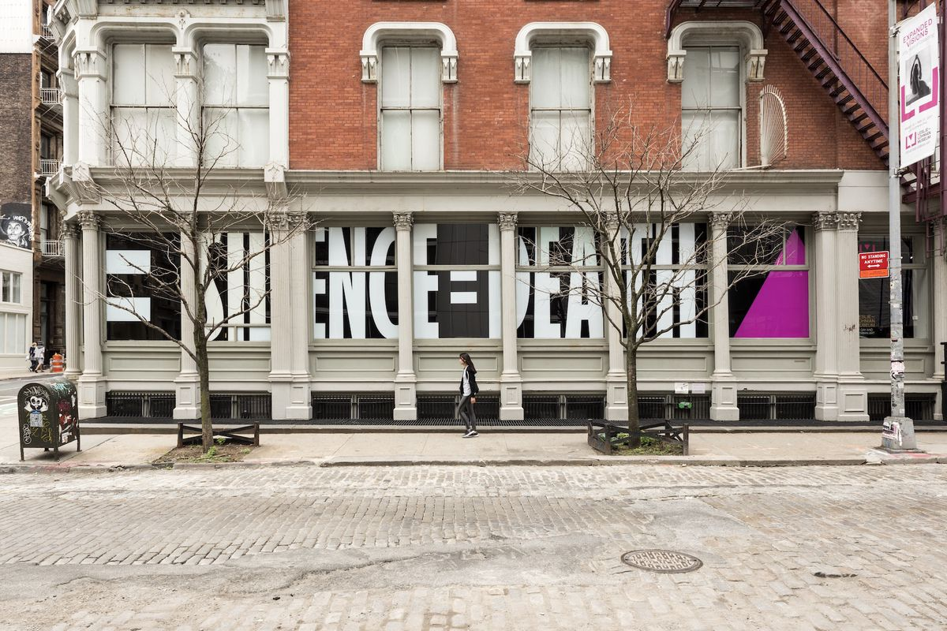

Slide 27
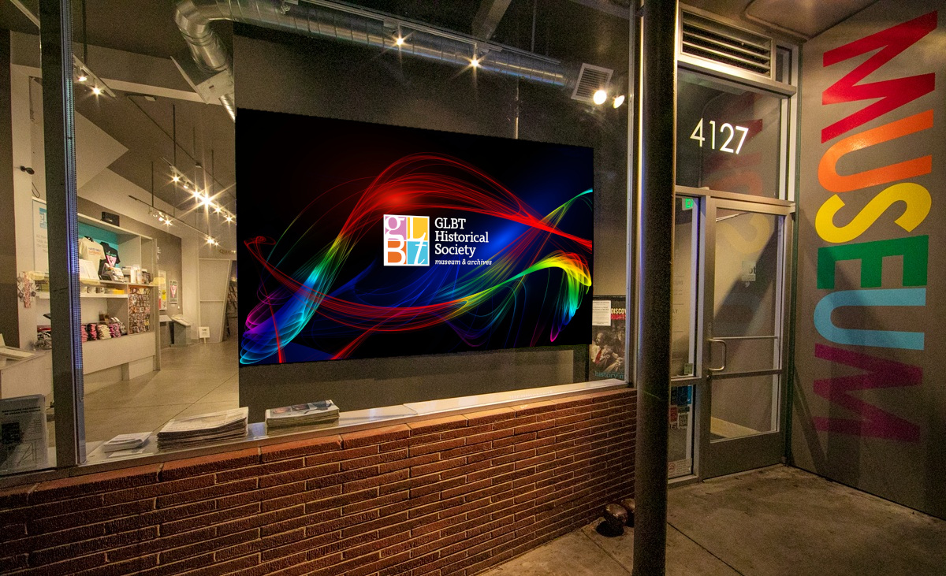

Slide 28
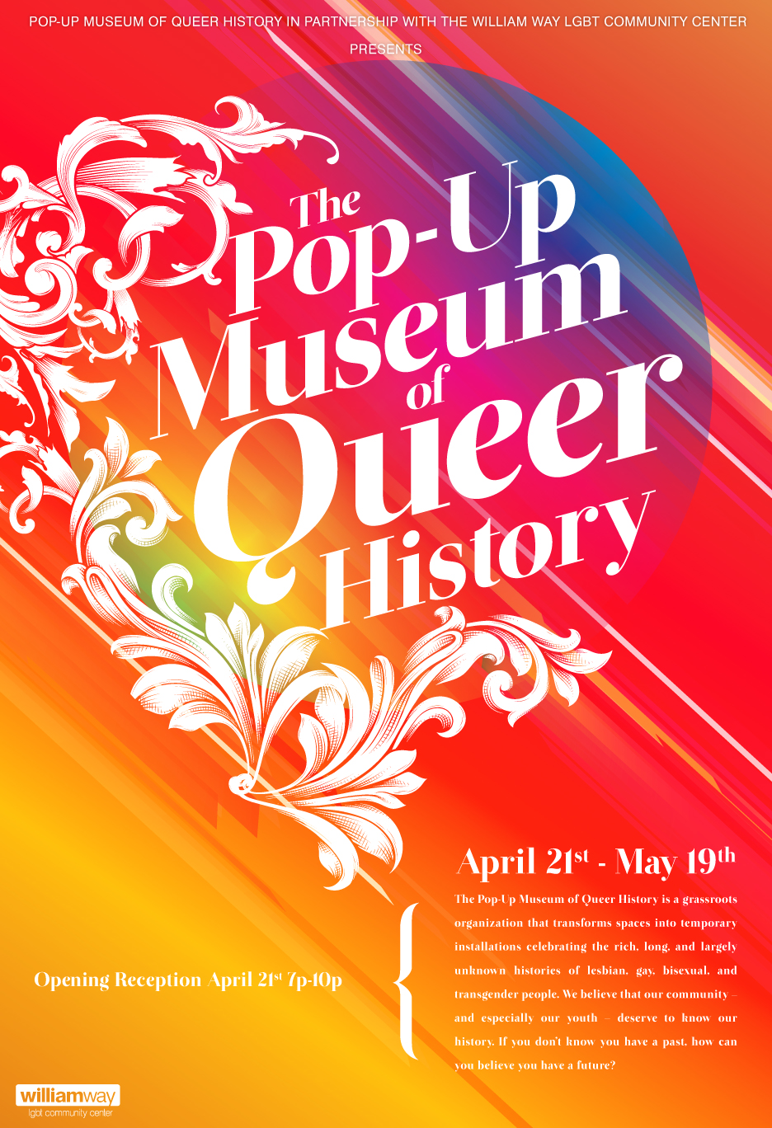

Slide 29
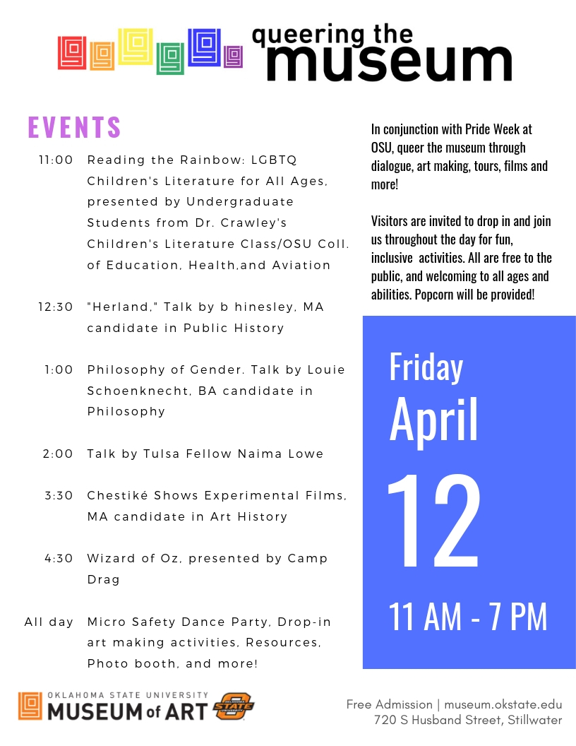

Slide 30
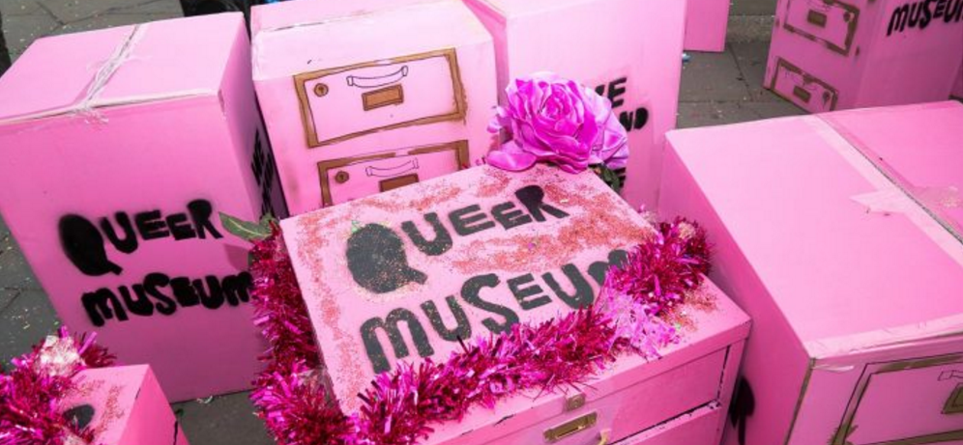

Slide 31
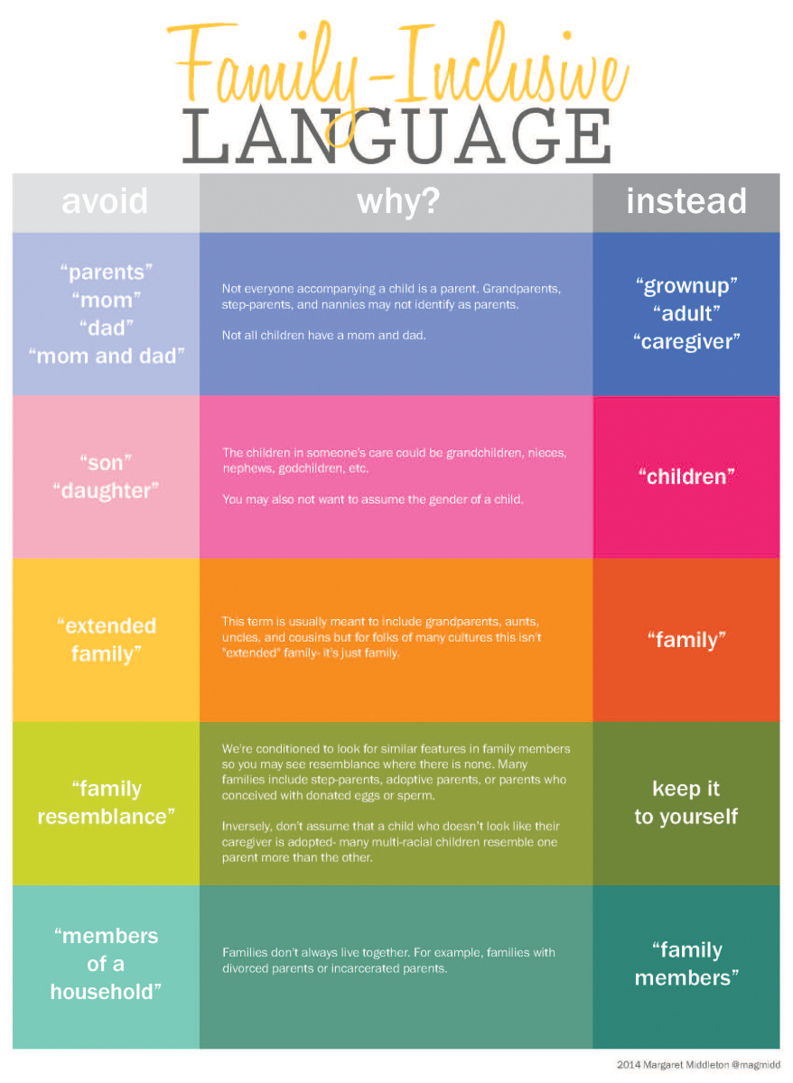

Slide 32
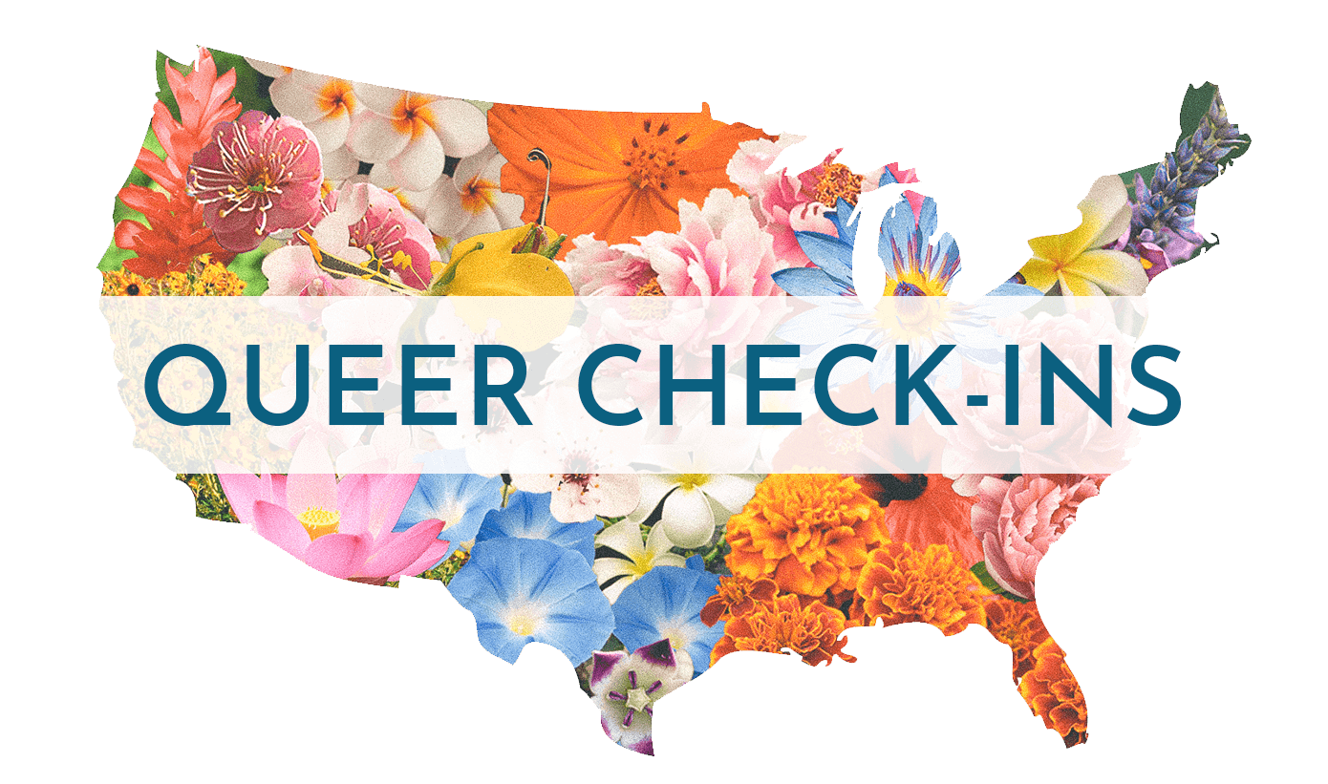
Smithsonian Asian Pacific American Center

Slide 33
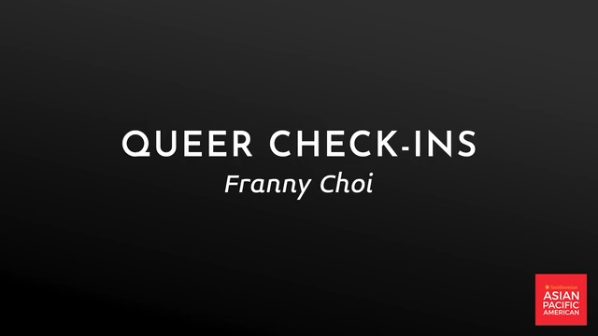
Are You Okay? Edited by Emmanuel Mones, 2018

Slide 34
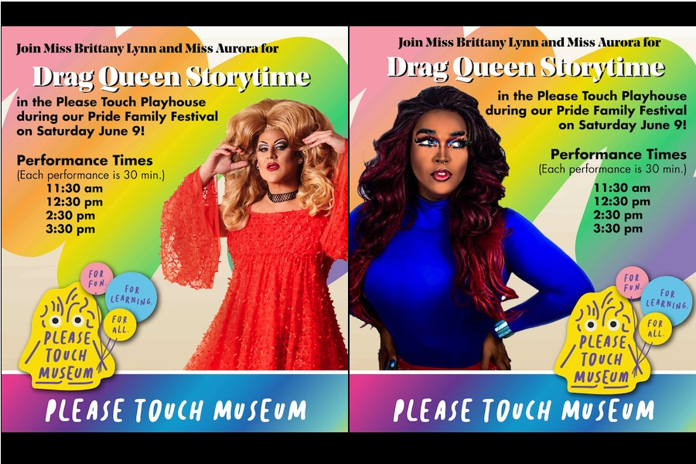

Slide 35
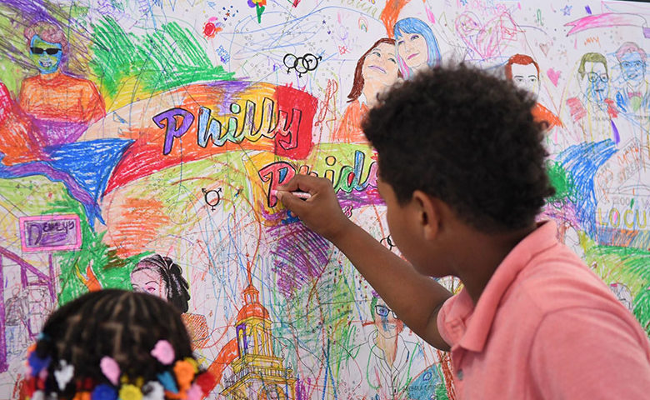

Slide 36
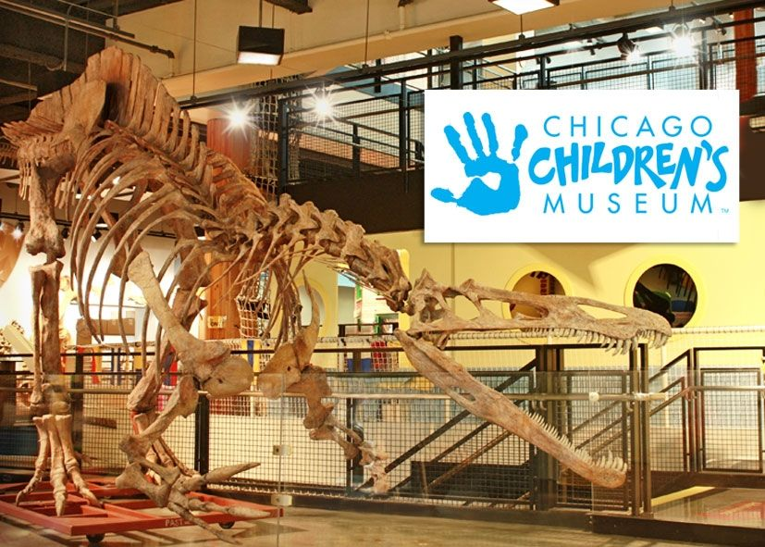


Slide 37
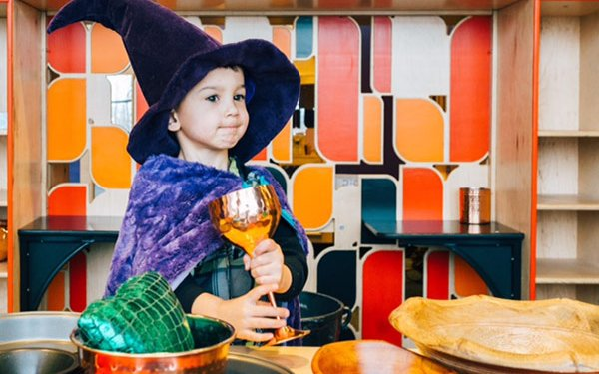
Gender-inclusive fairy tale exhibit at Chicago Children’s Museum

Slide 38
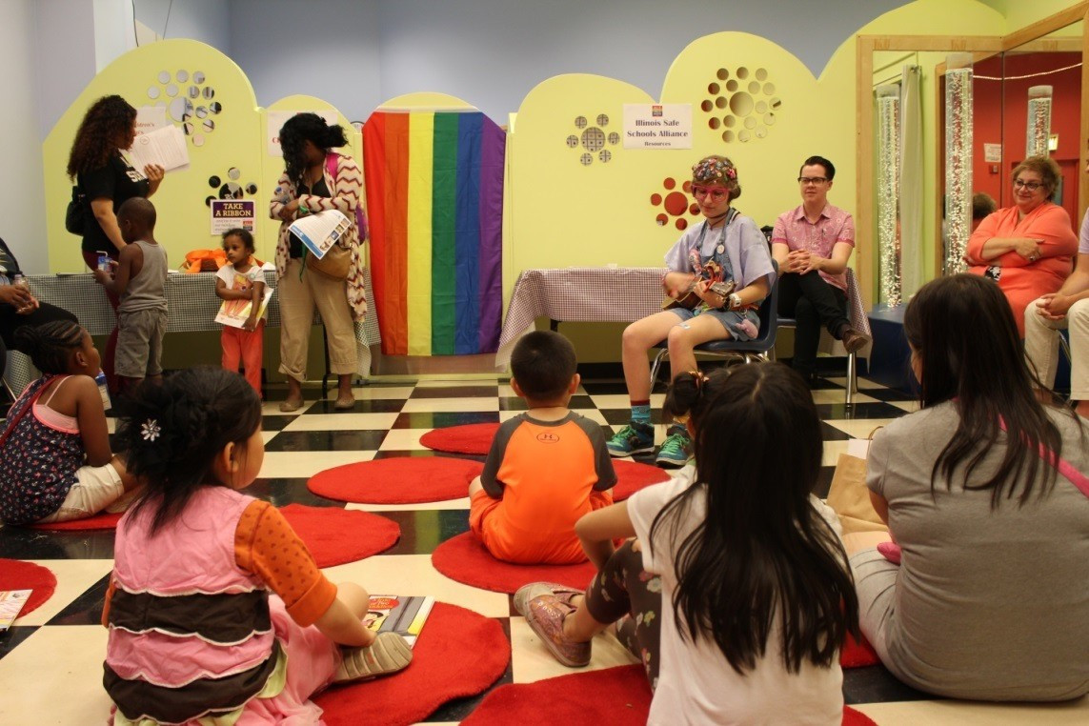
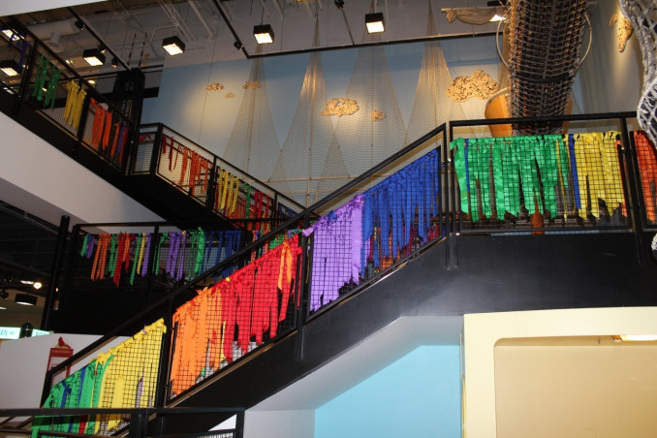
International Family Equality Day and Pride Month
Chicago Children’s Museum

Slide 39
International Family Equality Day and Pride Month
Chicago Children’s Museum
The museum set up a Hospitality Suite and Resource Room, with “Materials and Support for LGBT families and friends.”
And invited visitors to:
Write on a chalkboard, expressing their ideas about “What Makes a Family?” and reflecting on commonalties among families.
Make Family Flags to share the unique make-up of all families.
Be part of a family group photo in front of the Rainbow Staircase.
Participate in a video shoot about what makes their family special.

Slide 40
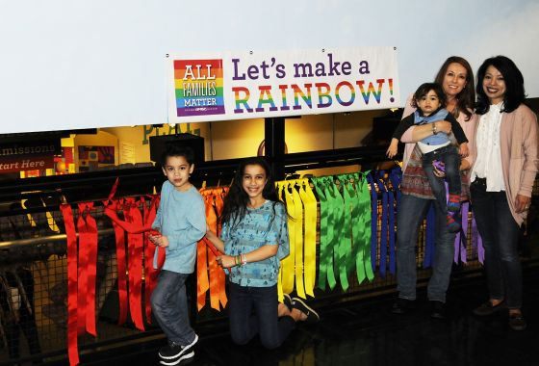
Santos-Volpe Family at Chicago Children’s Museum, Windy City Times, Hal Baim, 2015

Slide 41

Pride Month Drag Queen Story Time at Chicago Children’s Museum, 2018

Slide 42
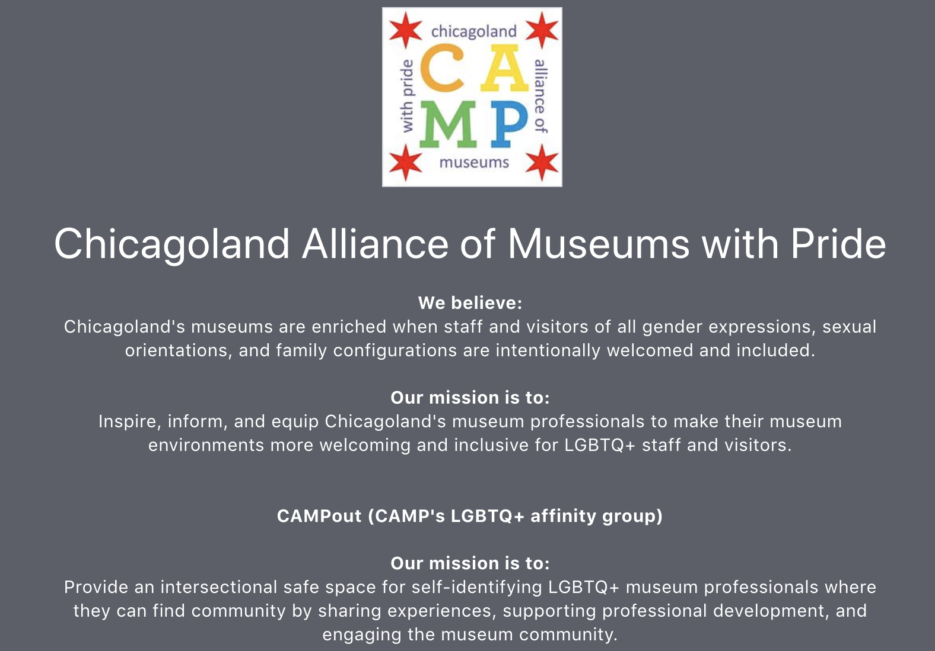

Slide 43
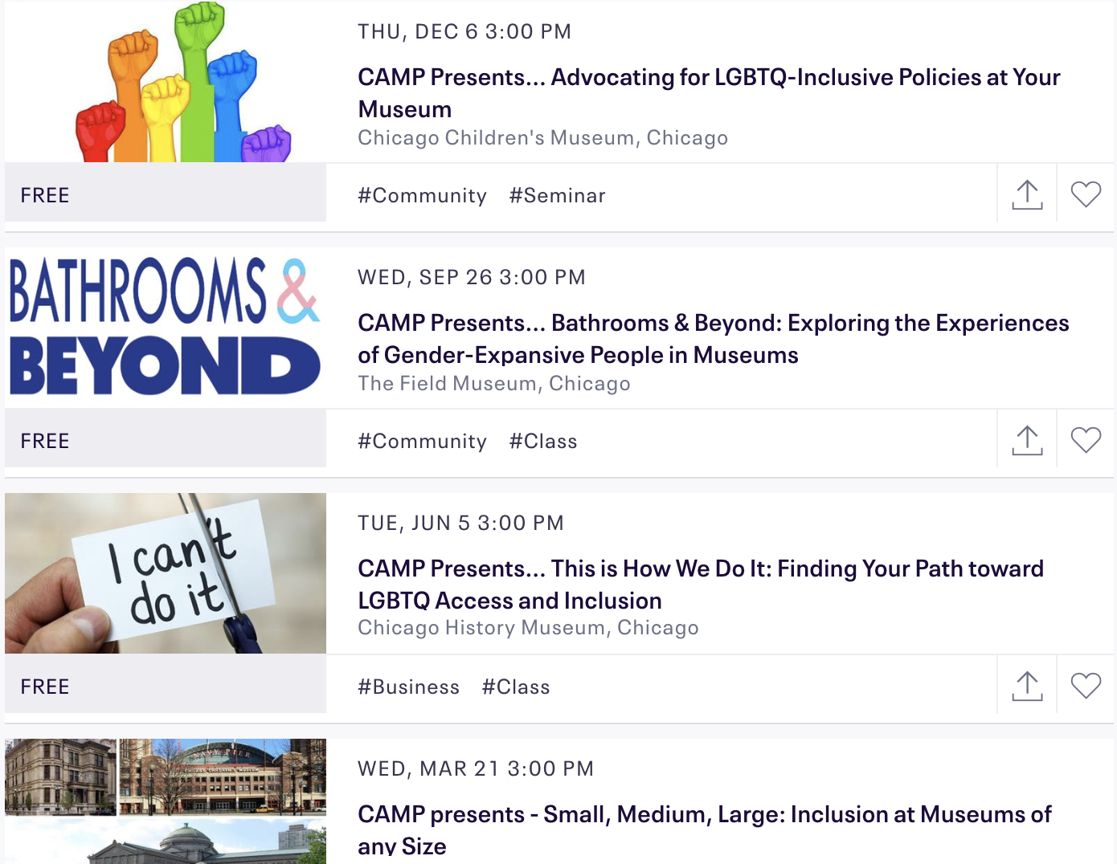

Slide 44
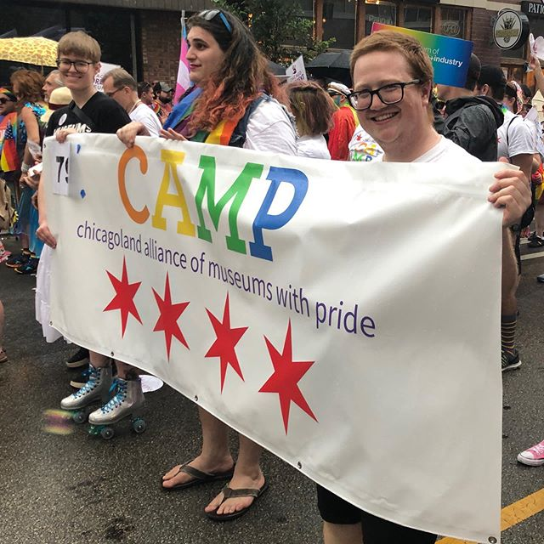

Slide 45
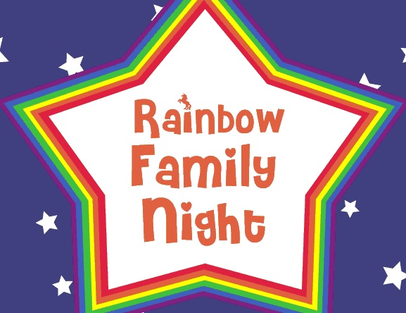
Habitot Children’s Museum, Berkeley, California

Slide 46
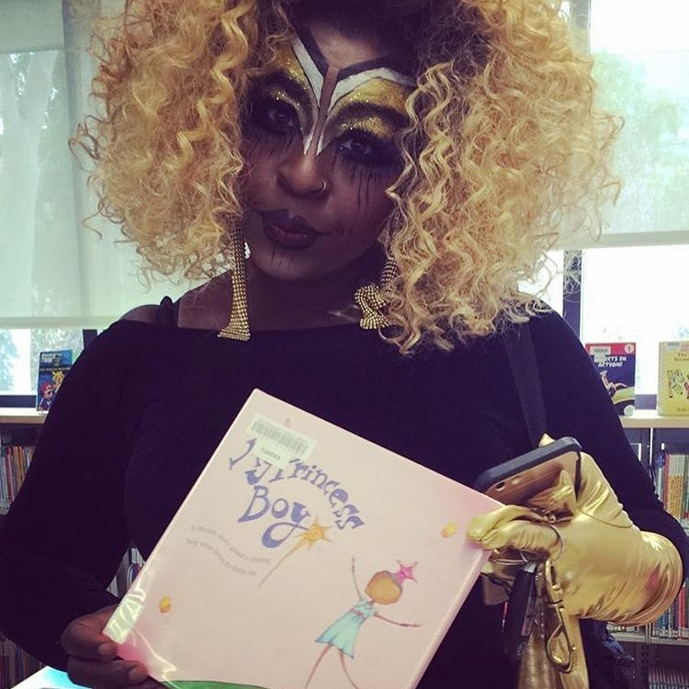
Juneteenth Drag Queen Story Hour, Beatrice L. Thomas aka Black Benatar, Berkeley Art Center

Slide 47
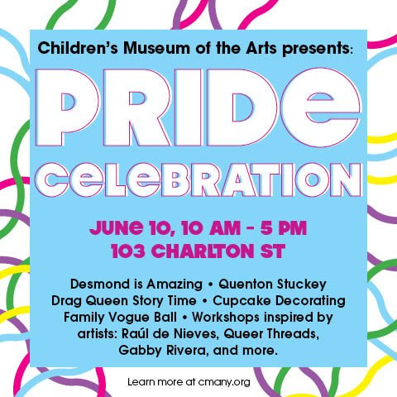

Slide 48
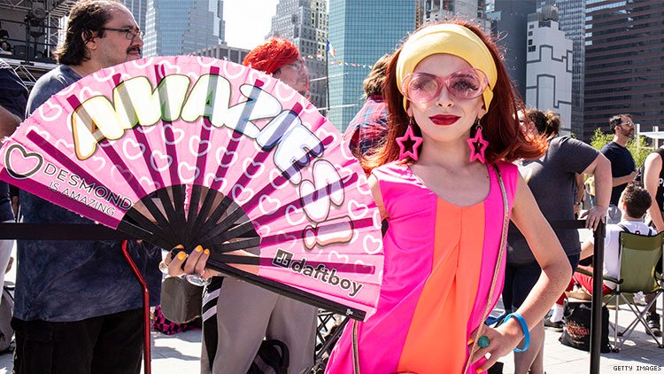
Desmond Is Amazing

Slide 49
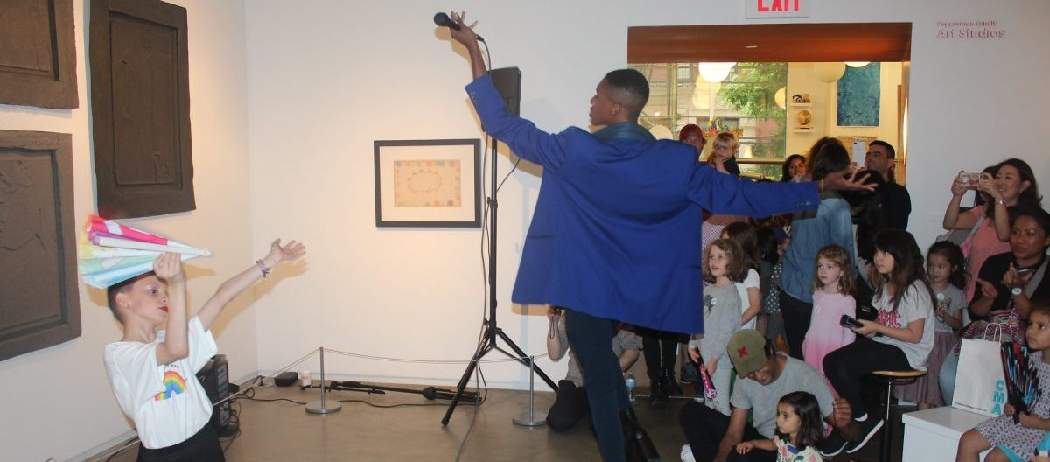
Preparing for Mini-Vogue Ball, Desmond is Amazing and Quenton Stuckey, Children’s Museum of the Arts, 2019

Slide 50
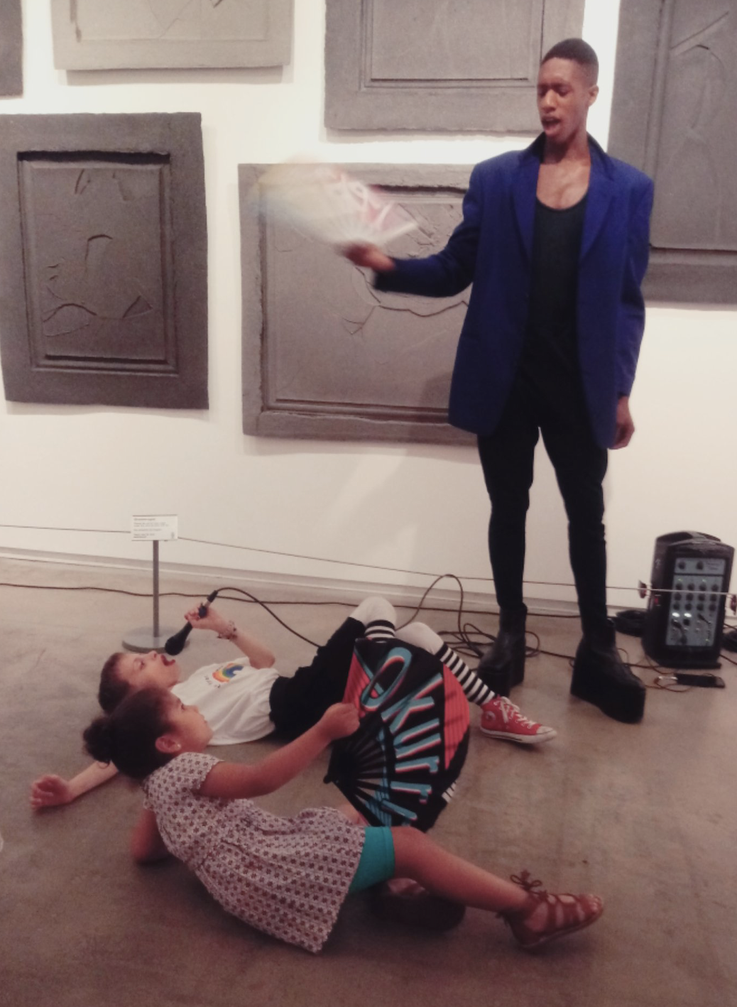
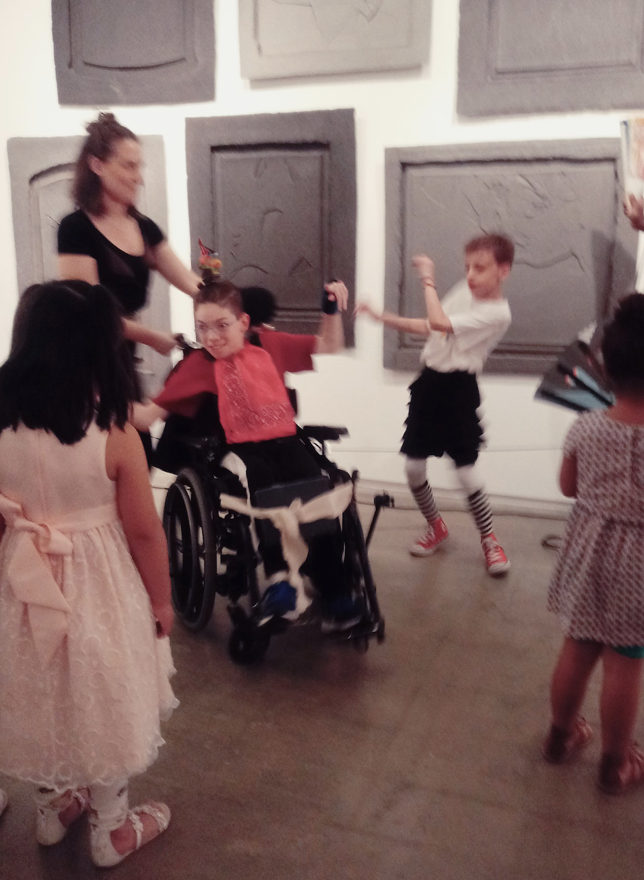

Slide 51


Slide 52


Slide 53

Black Lesbian Contingent, San Francisco Pride Parade, 1991 by H. Lenn Keller

Slide 54


The Q Sides, 2015

Slide 55


Slide 56

Participant in Bay Area American Indian Two-Spirits Pow Wow, 2019

Slide 57

Rainbow Flag (foreground) by Gilbert Baker, 1978

Slide 58


Slide 59


Slide 60

You Make Me Feel (Mighty Real) by Sylvester, 1978. Video by Lázaro.

Slide 61

Kiitos
Email me at therese.quinn@gmail.com

